Slide 1
BCG MATRIX ANALYSIS
Submitted by: Shachee Desai
Enrollment Number: 160410116027
Branch: Information Technology
Subject: Engineering Economics and Management

Slide 2
What is BCG Analysis?
It was created by the Boston Consulting Group.
It is designed for long term strategic planning.
It is also known as GROWTH/SHARE Matrix.
It is important to analyse the investment, growth and dissolvement of a product.

Slide 3
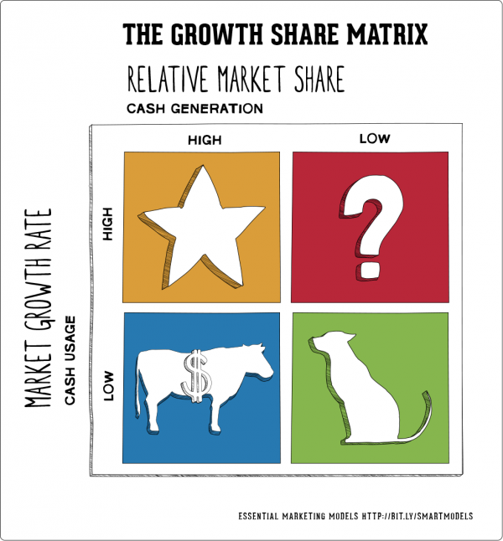
The Four Parts of the BCG Matrix
Part 1: Stars
New product.
Part 2: The Question Mark/ Problem Child
Developing products
Part 3: Cash Cows
The matured products
Part 4: Dogs
The end life of the original product.

Slide 4

Using the BCG Matrix Analysis
Step 1. Choose the unit
Step 2. Define the market
Step 3. Calculate relative market share
Step 4. Find out market growth rate
Step 5. Draw the circles on a matrix

Slide 5
Strategic Choices
Build – Stars
Making investments
Increasing market shares
Hold – Question Marks
Maintaining a hold on the market
Maintaining Investments
Harvest – Cash Cows
Profiting from returns on investment
Divest – Dogs
Releasing assets that are not beneficial.
E.g. selling of shares.

Slide 6
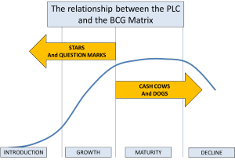
Product Life Cycle and BCG
Introduction Stage
Growth Stage
Maturity Stage
Decline Stage

Slide 7
Limitations of BCG Analysis
Its quadrants are an oversimplified version of reality.
“Market” is a loosely used term in the analysis
Does not consider external factors
High market shares do not mean high market profitability.
It denies interactions between different stages exists.

Slide 8
Case Study: Nokia Mobiles
Nokia is a Finnish multinational communications and information technology corporation, headquartered in Keilaniemi, Espo, Finland.
Its principal product are mobile telephones and portable IT devices.
It also offers internet services that include applications, games, music, media, messaging, free-of-charge digital map information, and navigation services through its wholly owned subsidiary Navteq
It has a joint venture with Siement, creating the Nokia Siemens Networks which provides telecommunications network equipment and services.
It is a public limited-liability company listed on the Helsinki Stock Exchange and New York Stock Exchange.
From 1998 to 2012 it remains the world’s largest vendor of mobile phones.
Due to the increase of smartphones it’s market share has declined from US$40 to US$30

Slide 9
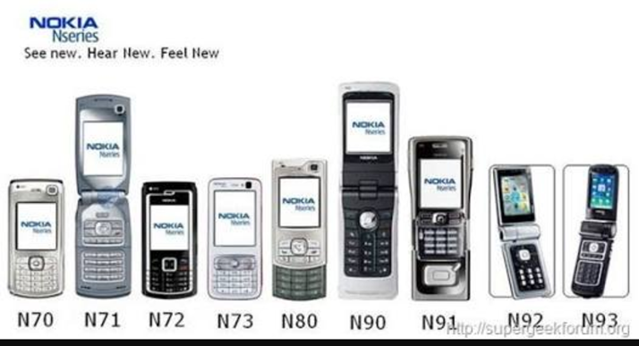
Case Study: Nokia Mobiles
Stars:
The N-series was a product that had a large market share and market growth.
It was quickly appreciated by customers.
Its cash generation was huge but required a high initial investment.

Slide 10
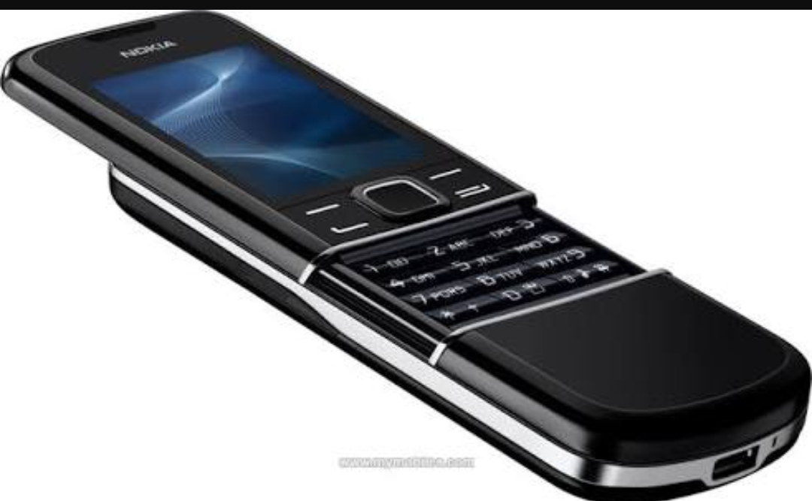
Case Study: Nokia Mobiles
Question Marks:
The Premium series was a product that had a low relative market share.
They required attention to determine if the venture will be viable.
Their sales were very low.
It was not as per the needs of the customers.

Slide 11
Case Study: Nokia Mobiles
Cash Cows:
“Milk the cow as much as you can without killing it”
Despite the dwindling markets shares, Nokia was able to maintain a hold on their customers through its previous products.
Their profitability was maintained with virtually no marketing support.

Slide 12
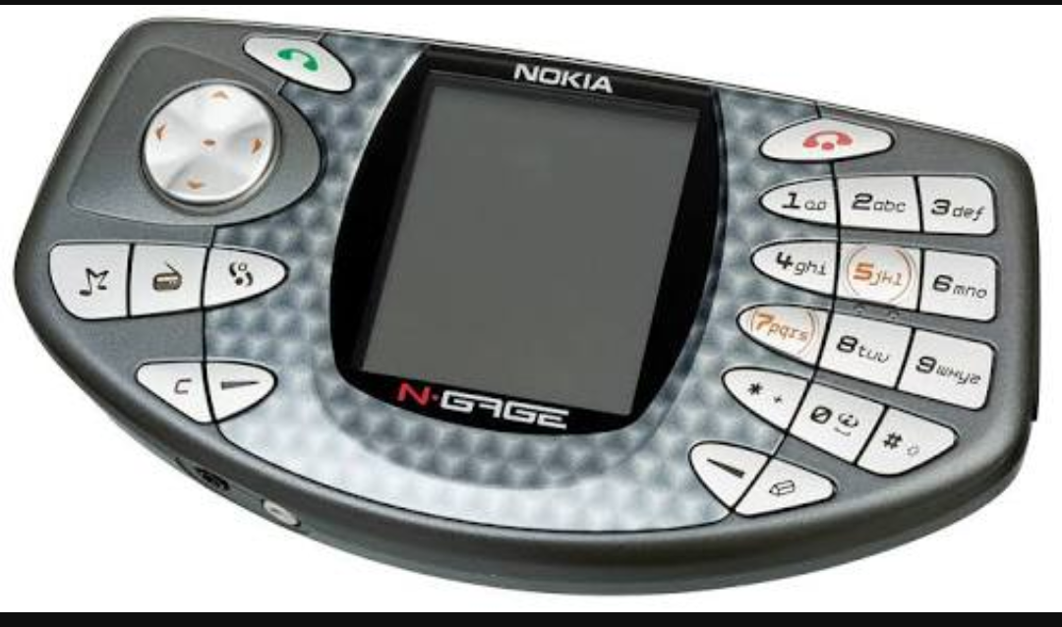
Case Study: Nokia Mobiles
Dog:
N-gage: This is a product that did not generate much market growth nor did it produce any market shares.
With such a product the company has to decide whether to slow or shut down the production.

Slide 13
Conclusion
To conclude, while the BCG analysis is an easy way for new enterprises to have a relative idea of the market, it misses out on multiple aspects that only market growth details can not provide.
Thus, the BCG analysis paired with others such as SWOT analysis would give a more accurate input.

